Slide 1
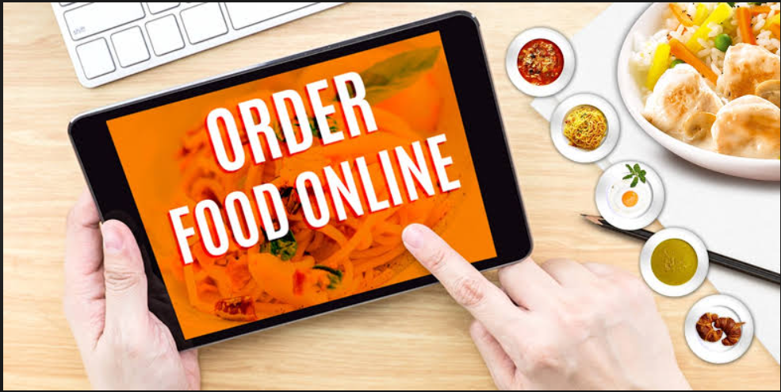

Translucent food Ordering Website
Submitted to:
Dr. Baljit Kaur
Mr. Vikas Patel
Submitted by:
Janvi Sethi (2210990431)
Jasleen Kaur(2210990447)
Jasneet Singh(2210990452)
Kunal (2210990527)

Slide 2

Table Of Contents
Introduction
Problem Statement
Key Features
Technical Details
Project Highlights
Project goals
Conclusion
References/Links used

Slide 3
Introduction
In this project our primary objective is to develop a cutting-edge food delivery application using the powerful React.js framework. Our aim is to revolutionize the way users interact with food delivery services, providing them with an unparalleled experience that seamlessly integrates convenience, choice, and efficiency.

Slide 4
Problem Statement
In today's fast-paced world, consumers increasingly rely on food delivery services to satisfy their culinary cravings and convenience needs. However, existing food delivery platforms often fail to provide a seamless and personalized experience that caters to the diverse preferences of modern users. There is a clear opportunity to develop a sophisticated food delivery application that not only streamlines the ordering process but also enhances user engagement and satisfaction.

Slide 5

Key Features
Intuitive Ordering Interface: Users can easily browse restaurant menus, customize orders, and place requests with simplicity.
Real-Time Order Tracking: Users receive updates on order status from confirmation to delivery, ensuring transparency.
Secure Payment Integration: Multiple payment options with robust security measures for safe transactions.
Rating and Review System: Users can provide feedback on restaurants and delivery experiences, enhancing trust.
Accessibility and Inclusivity: Features like screen reader compatibility and adjustable text sizes ensure accessibility for all users.

Slide 6
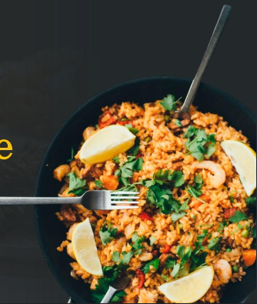
Technical Details
HTML, CSS: For structuring, styling, and adding interactivity to the user interface, ensuring a seamless and visually appealing experience.
React Native or Flutter: For building cross-platform mobile apps with a single codebase.
JavaScript/Typescript: Main programming language for frontend development.
Fetch API: For making HTTP requests to the backend server.

Slide 7
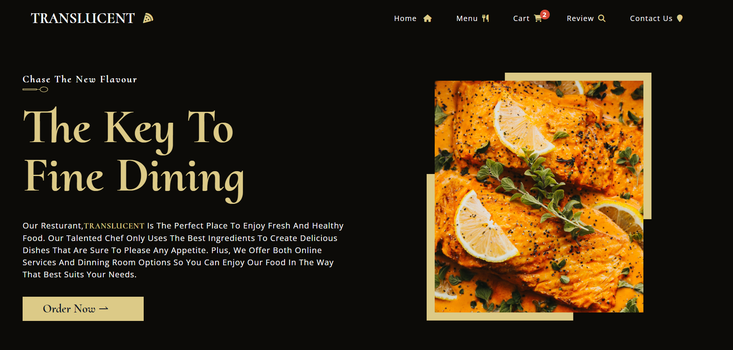
Project Highlights
Main page

Slide 8
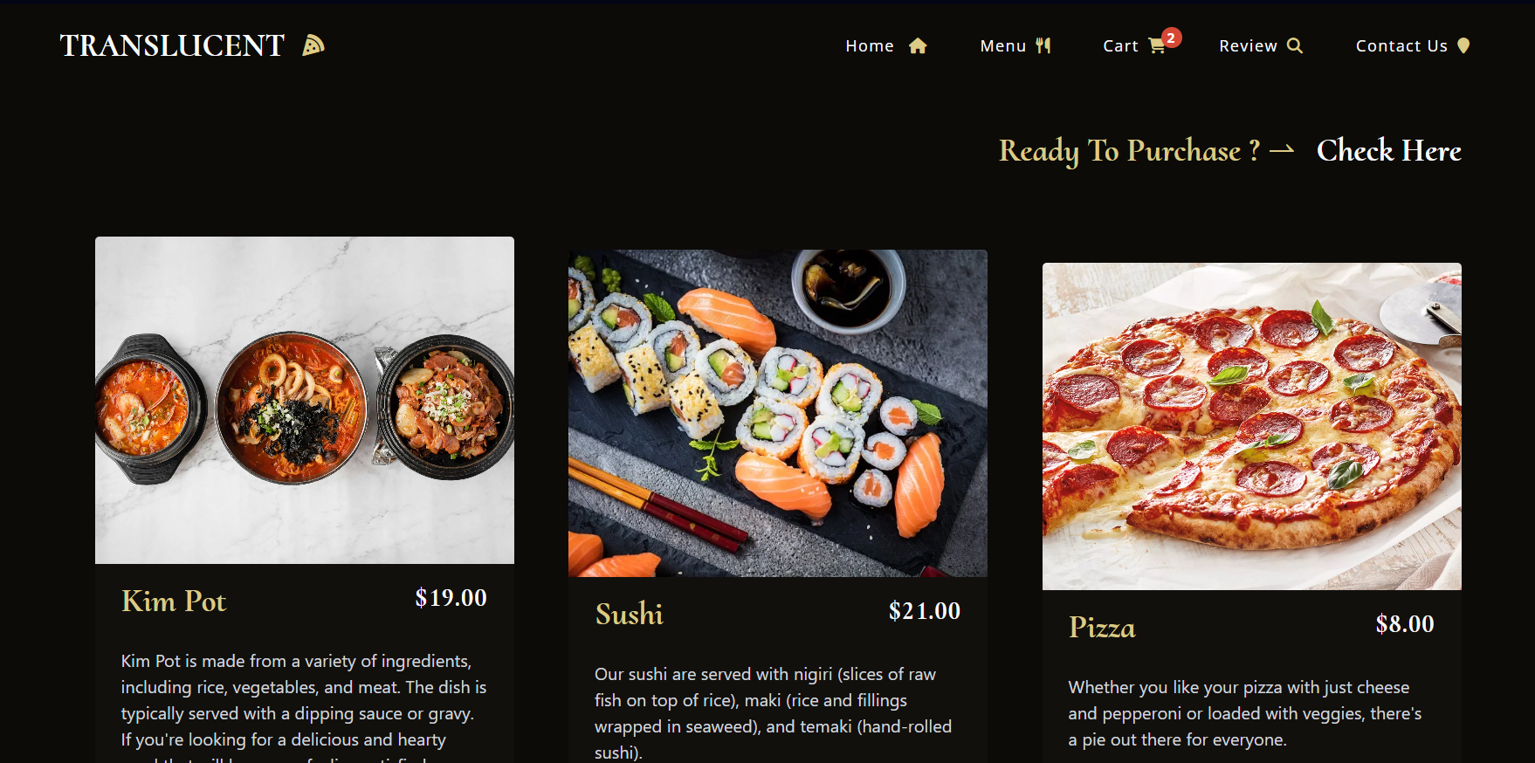
Menu page

Slide 9
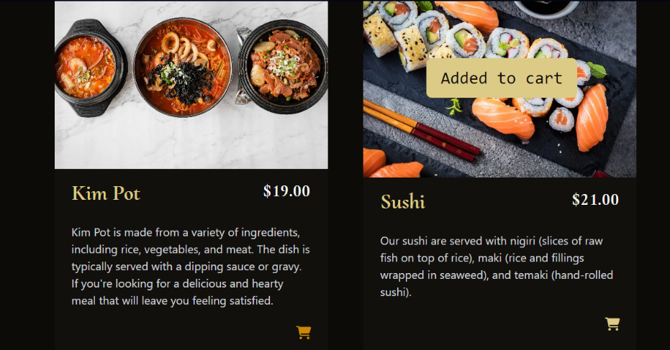
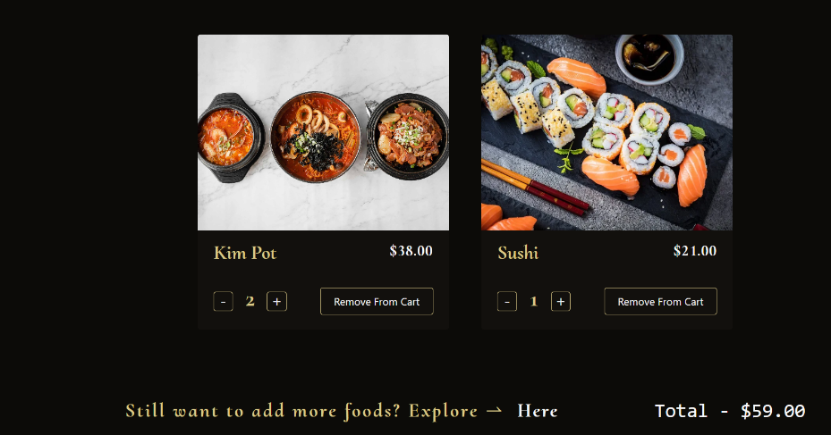
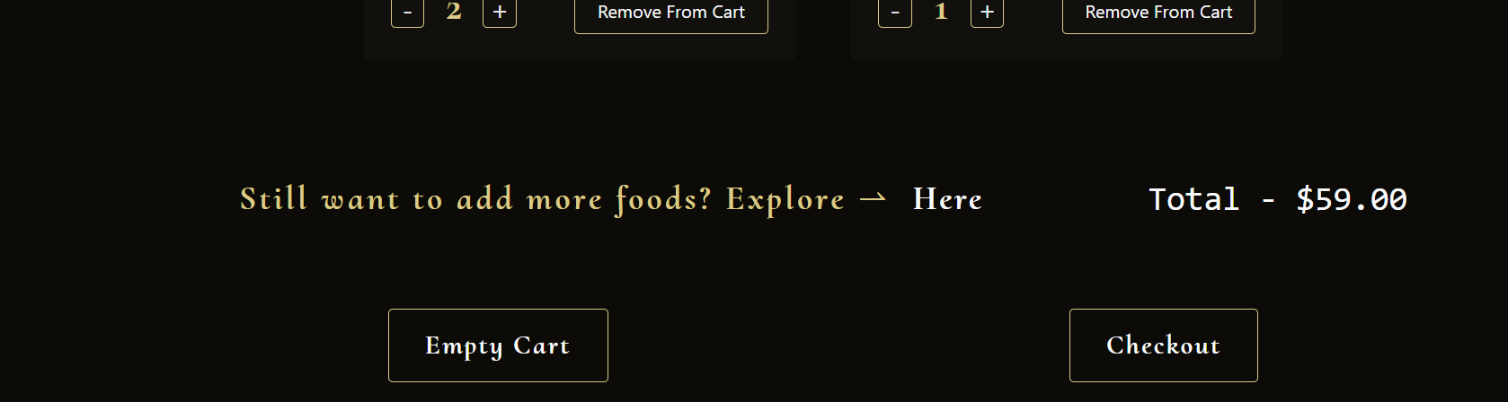
Add to cart page

Slide 10
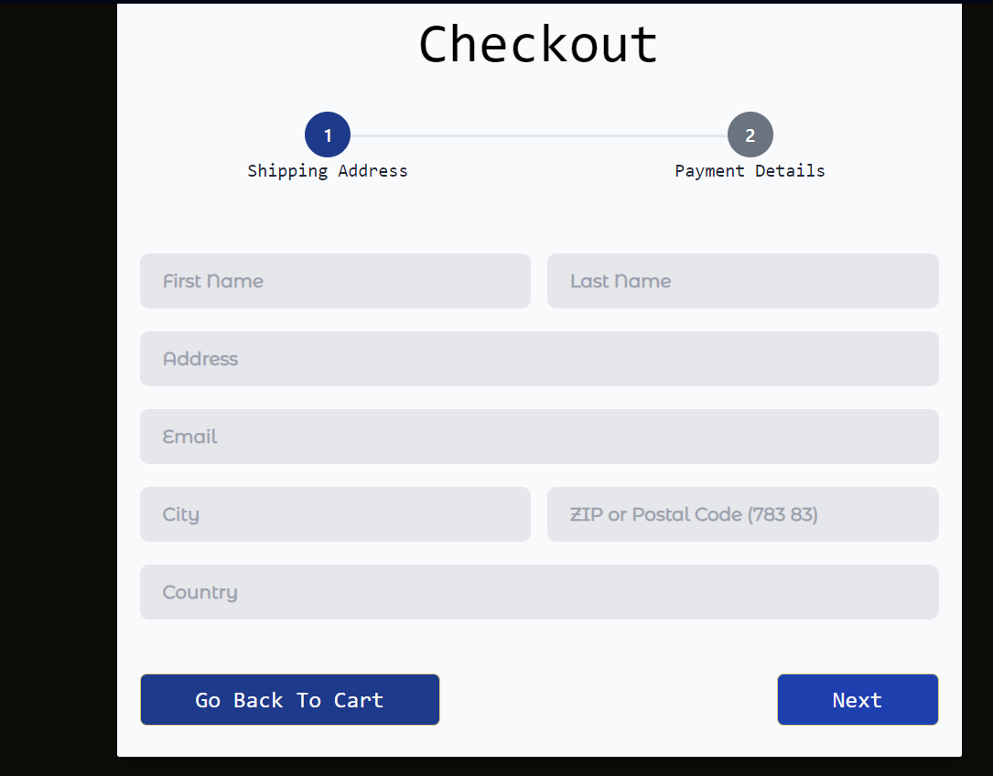
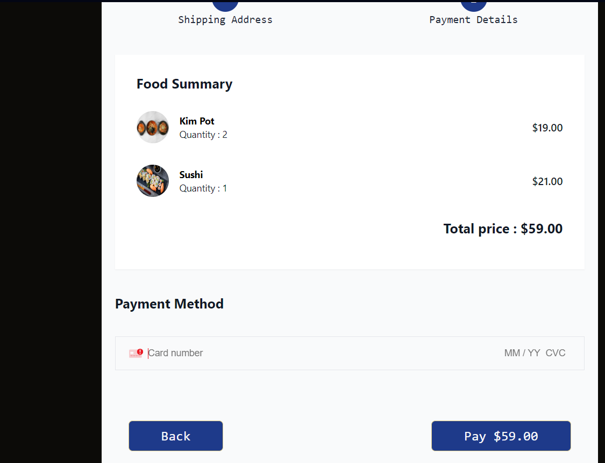
Checkout Page

Slide 11
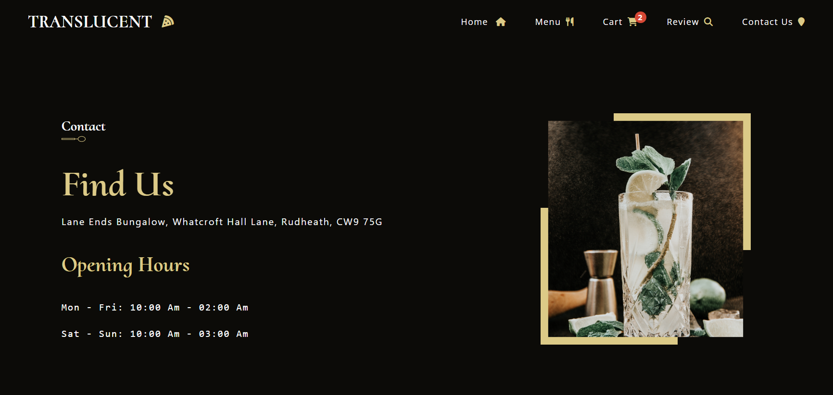
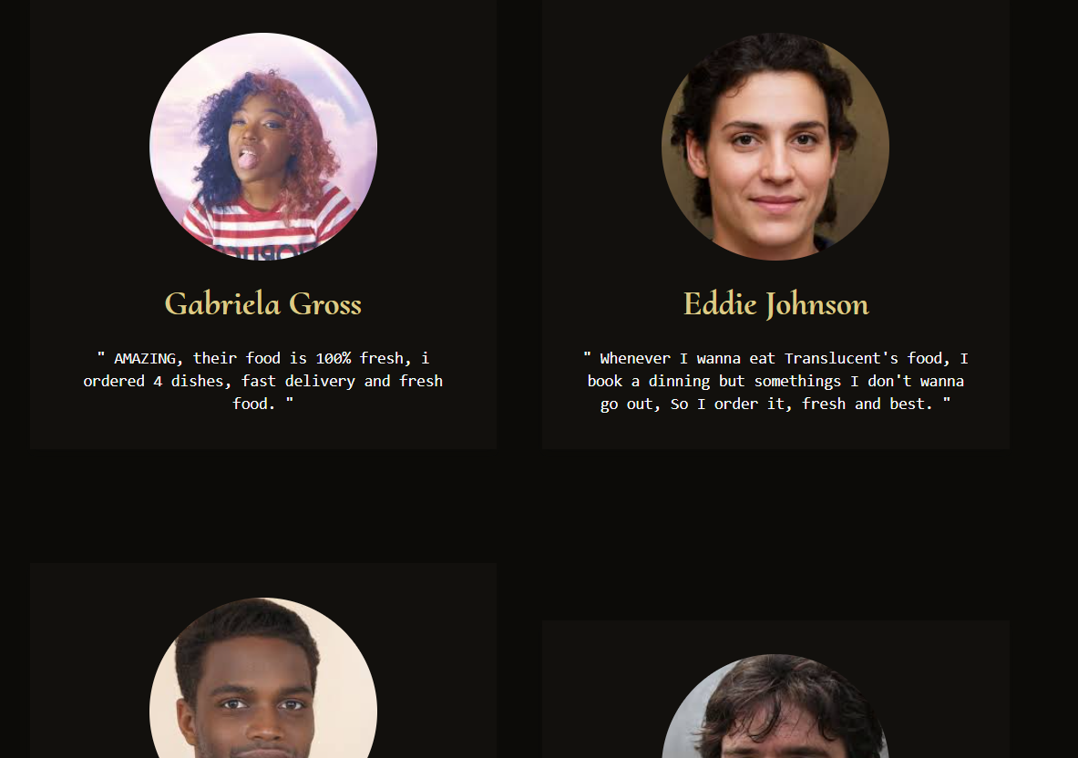
Contact us/review page

Slide 12

Project Goals
Our goal with translucent-food is to create a market-leading food delivery application that sets new standards for convenience, reliability, and user satisfaction. By combining innovative technology with a user-centric approach, we aim to transform the way people experience food delivery, making it not just a service but a delightful and memorable culinary journey.

Slide 13
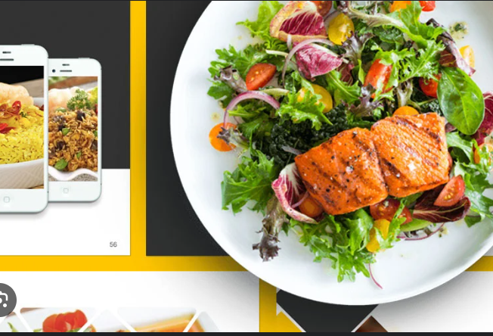
Conclusion:
Join us on this exciting journey as we embark on the development of translucent-food— a next-generation food delivery application that promises to redefine the way people eat, one delicious meal at a time.

Slide 14
References
MDN Web Docs - https://developer.mozilla.org/en-US/docs/Web
W3Schools - https://www.w3schools.com/
CSS-Tricks - https://css-tricks.com/
Codecademy - https://www.codecademy.com/
Stack Overflow - https://stackoverflow.com/

Slide 15


